Slide 1
Internet of Things (IoT), Artificial Intelligence and Internet Governance
Sanjeeb Prasad Panday (PhD)
Assistant Professor
Department of Electronics and Computer Engineering
Pulchowk Campus, Institute of Engineering, Tribhuvan University
Acting Director
Information and Communication Technology Centre (ICTC)

Slide 2
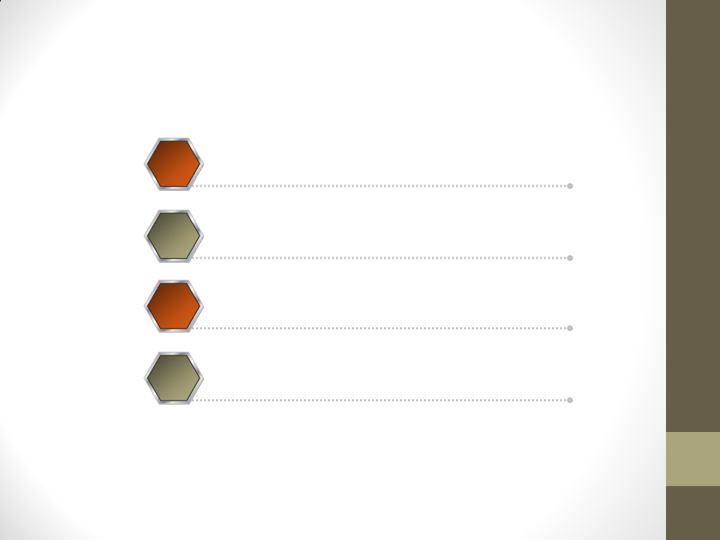
Outline
1
2
3
4
What’s Internet of Things (IoT)
State of the Art of IoT
Challenges and Limitation of IoT
Future of IoT

Slide 3
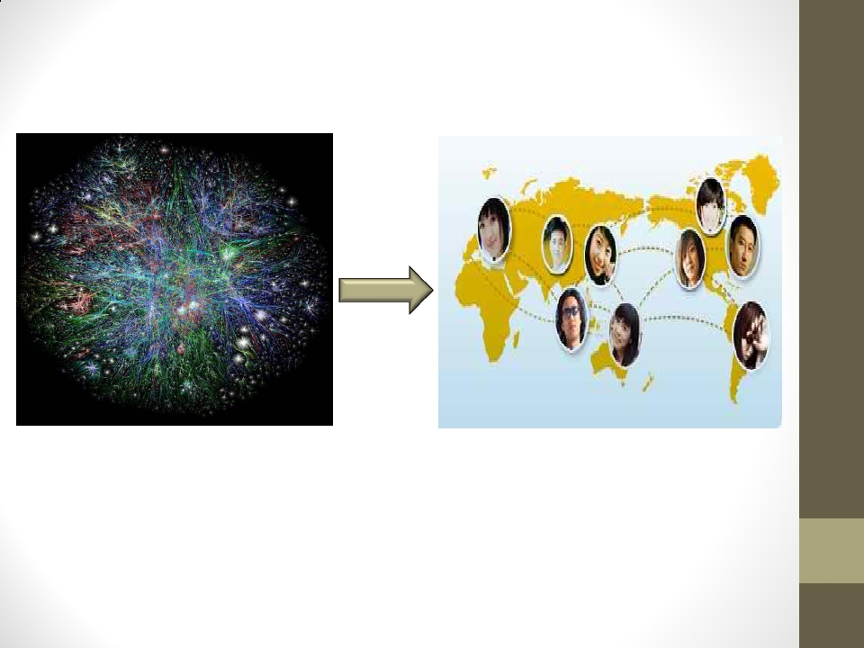
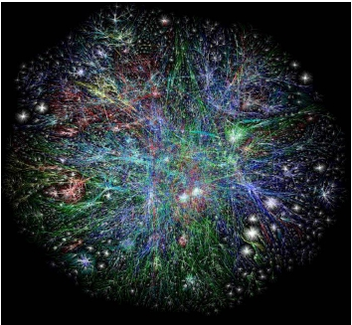
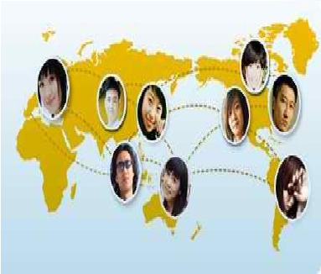
Starting from the Internet
• Internet appears everywhere in the world
• but it is still a connection between people and people

Slide 4
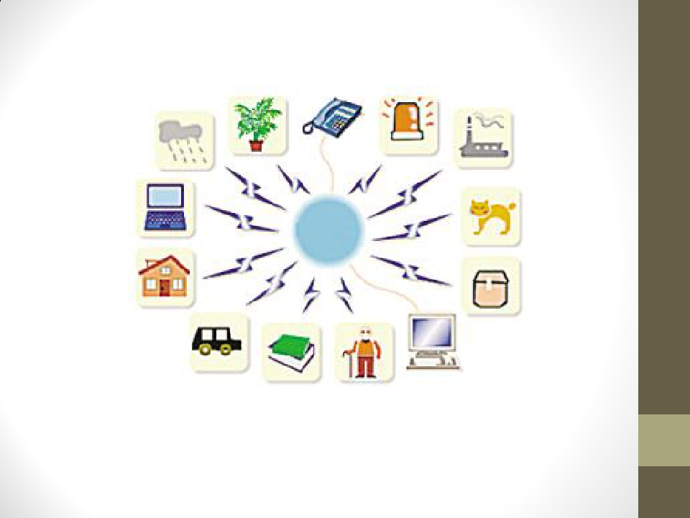
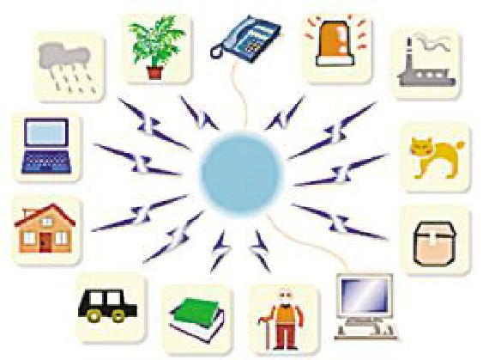
What is the Internet of Things?
• Internet connects all people, so it is called “the Internet of People”
• IoT connects all things, so it is called “the Internet of Things”

Slide 5
What’s the Internet of Things
▪ Definition
(1) The Internet of Things, also called The Internet of
Objects, refers to a wireless network between objects,
usually the network will be wireless and self-configuring,
such as household appliances.
------Wikipedia
(2) By embedding short-range mobile transceivers into a
wide array of additional gadgets and everyday items,
enabling new forms of communication between people
and things, and between things themselves.
------WSIS (World Summit on Internet Society 2005)

Slide 6
What’s the Internet of Things
▪ Definition
(3) The term "Internet of Things" has come to describe a
number of technologies and research disciplines that
enable the Internet to reach out into the real world of
physical objects.
------IoT 2008
(4) “Things having identities and virtual personalities
operating in smart spaces using intelligent interfaces to
connect and communicate within social, environmental,
and user contexts”.
-------IoT in 2020

Slide 7
What’s the Internet of Things
• History
▪ 1997, “The Internet of Things” is the seventh in the series of ITU
Internet Reports originally launched in 1997 under the title
“Challenges to the Network”.
▪ 1999, Auto-ID Center founded in MIT
▪ 2003, EPC (Electronic Product Code) Global founded in MIT
▪ 2005, Four important technologies of the internet of things was
proposed in WSIS conference.
▪ 2008, First international conference of internet of things: The IOT
2008 was held at Zurich.

Slide 8
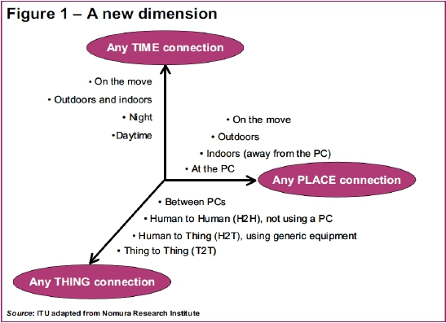
What’s the Internet of Things
From any time ,any place connectivity for anyone, we will
now have connectivity for anything!

Slide 9
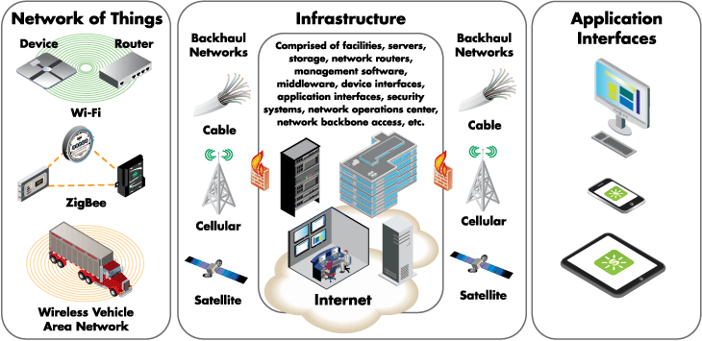
IoT Architecture
Source: digi.com
US San Francisco Bay Area Chapter

Slide 10
Internet of Things
TECHNOLOGIES FOR IOT

Slide 11
Technologies for IoT
• IoT’s realisation depends on continuous
technical innovation in a number of fields
– From wireless sensors to nanotechnology
• Main technological required in areas of
– Identification and Addressability
– Sensing
– Embedded Intelligence
– Miniaturisation

Slide 12
Identification & Addressability
Mechanisms
• Needed in order to connect everyday
objects and devices
– To large databases and networks
– So that data about things can be collected and
processed
• Radio-frequency identification (RFID) offers
ID functionality
– Also barcodes, 2D/3D codes
• IPv6 provides sufficient address space

Slide 13
Sensing
• To detect changes in the physical status of things
– Using sensor technologies
• Sensors play a pivotal role in bridging the gap
between the physical and virtual worlds
– Enable things to respond to changes in their physical
environment
– For example, sensors in an electronic jacket
• Collect information about changes in external temperature
and the parameters of the jacket can be adjusted
accordingly

Slide 14
Embedded Intelligence
• Embedded intelligence in the things
themselves
– To further enhance the power of the network
• By devolving information processing capabilities
to the edges of the network
• Empower things and devices at the edges
of the network to take independent
decisions

Slide 15
Miniaturisation
• Advances in miniaturization and
nanotechnology
– Smaller and smaller things will have the
ability to interact and connect

Slide 16
IoT
• A combination of all of these
developments will create an Internet of
Things
– Connecting the world’s objects in both a
sensory and an intelligent manner

Slide 17
Internet of Things
CHARACTERISTICS

Slide 18
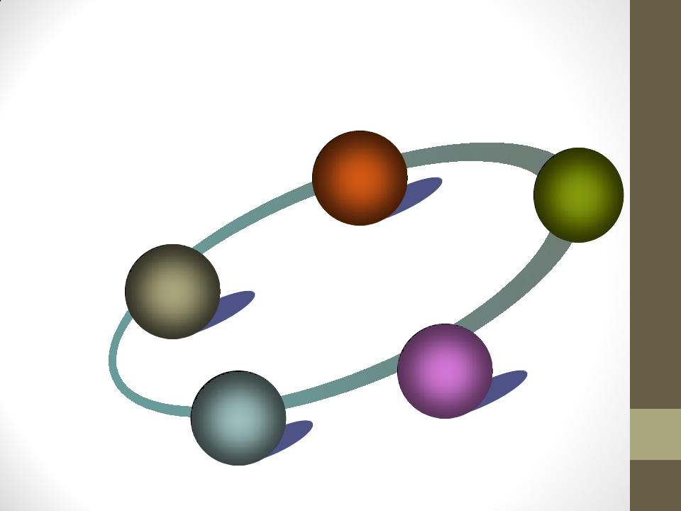
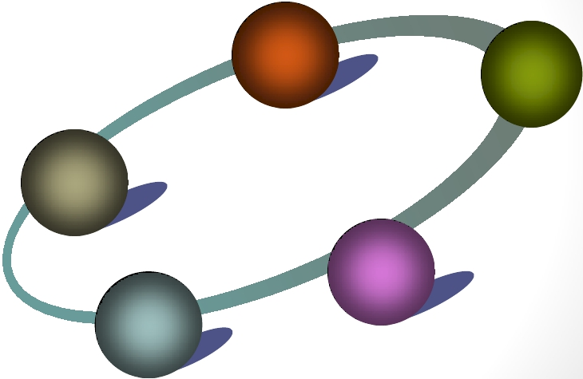
What’s the Internet of Things
Characteristics
Ambient
Intelligence
Flexible
Structure
Internet of Things
Semantic
Event
Driven
Complex
Access
Technologies
Sharing

Slide 19
Event Driven Architecture
• Likely to be an event-driven architecture
– Based on the context of processes and operations
• Event Driven Architecture
– Based on the production, detection, consumption of,
and reaction to events
• An event is an action that is usually initiated outside the
scope of a program and that is handled by a piece of code
inside the program
– Event driven systems are typically used when there is
some asynchronous external activity that needs to
be handled by a program

Slide 20
Ambient Intelligence
• Autonomous and intelligent entities
– Interoperable
– Able to auto-organise
– Act independently to pursue their own or shared
objectives
• Depending on the context, circumstances or environment
• Autonomous behaviour not part of the original
concept of the IoT
– Recent shift in research to integrate the concepts of the
Internet of Things and autonomous control
•
Autonomous Control and the Internet of Things : Increasing Robustness, Scalability and Agility
in Logistic Networks

Slide 21
Complex System
• IoT will be considered and studied as a
complex system
– Due to the huge number of different links/
interactions between autonomous actors
• And its capacity to integrate new actors
• Complex system
– A system composed of interconnected parts that
as a whole exhibit one or more properites not
obvious from the properties of the individual
parts

Slide 22
Complex Systems
• Characteristics include
– Cascading failures
– Difficult boundary determination
– May have memory (prior states may
have influence on present states)
– May be nested
– Non linear relationships (small
change, large effect i.e. the
butterfly effect)
– Feedback loops in relationships
• Effects of an element’s behaviour are
fed back to in such a way that element
itself is altered
• Examples of complex systems
whose models have been
developed
– Ant colonies
– Human economies, social structures
– Climate
– Nervous systems
– Cells and living things
– Human beings
– Modern energy and
telecommunication infrastructures

Slide 23
Semantic Interoperability
• IoT objects will be able to understand each other through semantic
interoperability
– Semantic interoperability: different stakeholders can access and
interpret the data unambiguously
• Required for automated information and communication in IoT
• Semantic annotation of the data can provide machine-
interpretable descriptions
–
–
–
–
–
What the data represents
Where it originates from
How it can be related to its surroundings
Who is providing it
What are the quality, technical, and non-technical attributes

Slide 24
Size and Time and Space
Considerations
• IoT will encode 50 to 100 trillion objects and be able
to follow the movement of those objects
– Humans in surveyed urban environments are each
surrounded by 1000 to 5000 trackable objects
• IoT will encompass billions of parallel and
simultaneous events
– Time will no more be used as a common and linear
dimension
• But will depend on each entity (object, process, information
system, etc.)
• Accordingly IoT based on massive parallel IT systems

Slide 25
Space Considerations
• The precise geographic location of a thing will be critical
– The Internet is primarily used to manage information processed by
people
• Relevance of location information about a thing is decided by a human user
– GeoWeb and Digital Earth concepts
• Search for things based on location instead of by keyword only – e.g. “What
is Here?”
• A virtual representation of the Earth that is georeferenced and connected
to the our digital knowledge archives
• Possible when things can become organized and connected by location
– Challenges remain
• Variable spatial scales
• Massive amounts of data
• Indexing for fast search and neighbour operations

Slide 26
Why Internet of Things
Dynamic control of industry and daily life
Improve the resource utilization ratio
Better relationship between human and nature
Forming an intellectual entity by integrating
human society and physical systems

Slide 27
Why Internet of Things(ii)
Flexible configuration
Universal transport & internetworking
Accessibility & Usability
Acts as technologies integrator

Slide 28
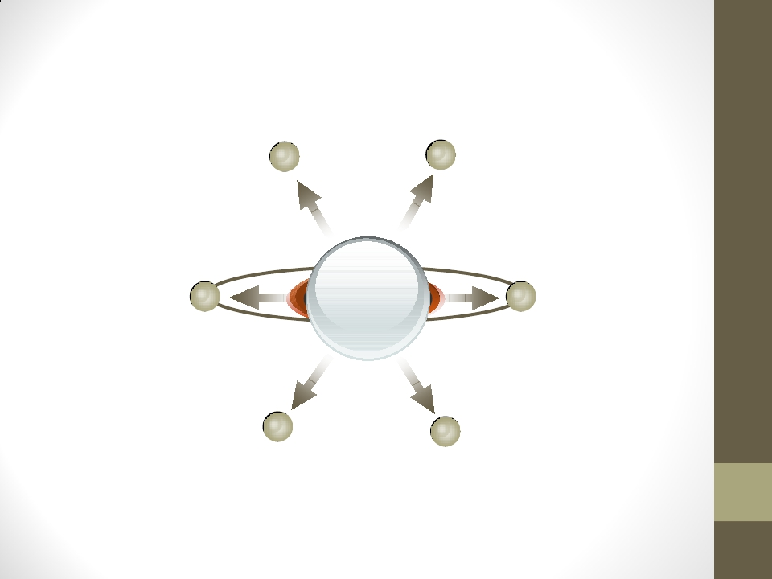
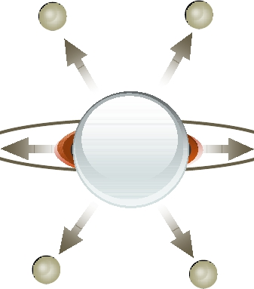
The Application of IoT(1)
Regional Office
Biosensor taken by people
House
Network
Equipment in
public place
Transportation Vehicle
Virtual Environment

Slide 29
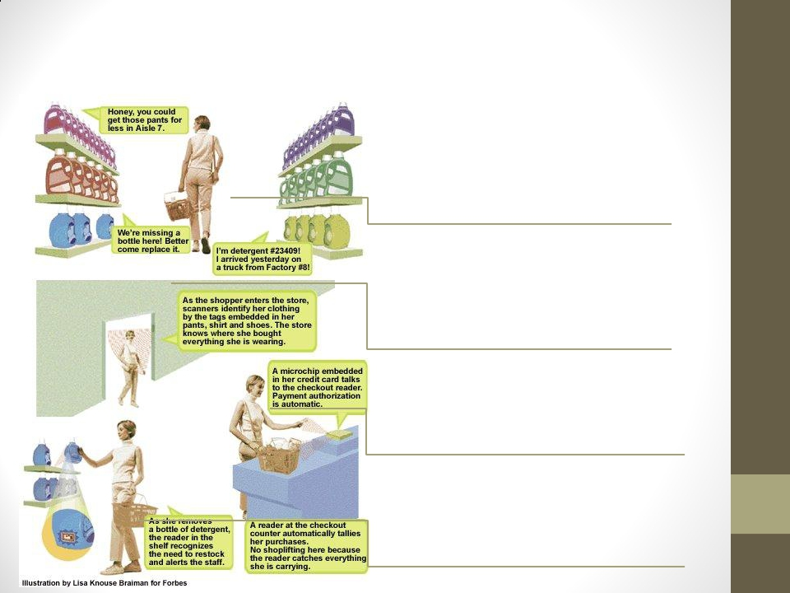
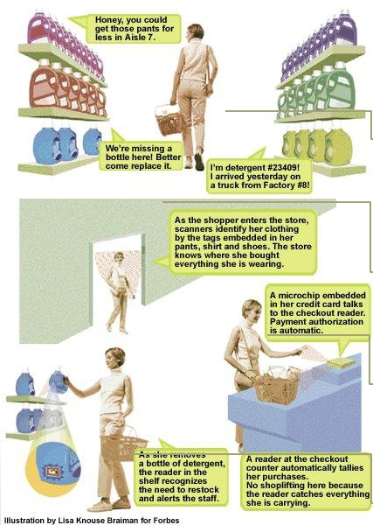
The Application of IoT(2)
Scenario: shopping
(2) When shopping in the market, the
goods will introduce themselves.
(1) When entering the doors, scanners
will identify the tags on her clothing.
(4) When paying for the goods, the
microchip of the credit card will
communicate with checkout reader.
(3) When moving the goods, the reader
will tell the staff to put a new one.

Slide 30
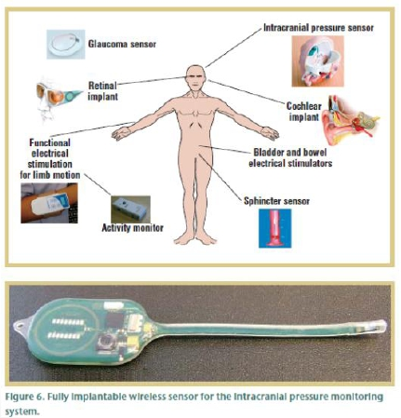
The Application of IoT(3)
Scenario: Health Care
•
•
•
•
•
•
Various sensors for various
conditions
Example ICP sensor: Short or
long term monitoring of
pressure in the brain cavity
Implanted in the brain cavity
and senses the increase of
pressure
Sensor and associated
electronics encapsulated in
safe and biodegradable
material
External RF reader powers
the unit and receives the
signal
Stability over 30 days so far

Slide 31
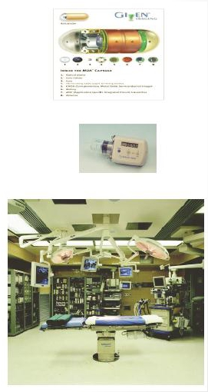
The Application of IoT(3)
Scenario: Health Care
• National Health Information Network,
Electronic Patient Record
• Home care: monitoring and control
Pulse oximeters, blood glucose monitors, infusion
pumps, accelerometers, …
• Operating Room of the Future
Closed loop monitoring and control; multiple treatment
stations, plug and play devices; robotic microsurgery
System coordination challenge
• Progress in bioinformatics: gene, protein
expression, systems biology, disease
dynamics, control mechanisms

Slide 32
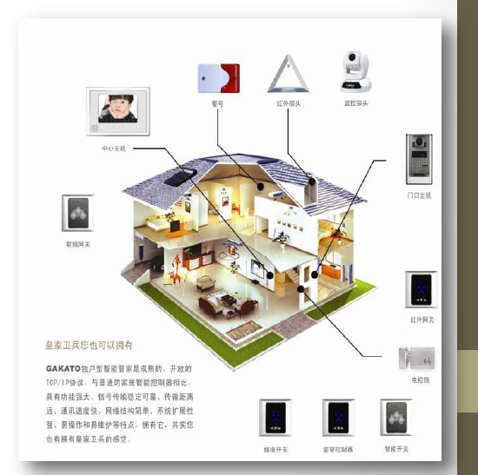
The Application of IoT(4)
Scenario: Intelligent Home
• Remote monitor for
smart house
• Remote control for
smart appliance

Slide 33
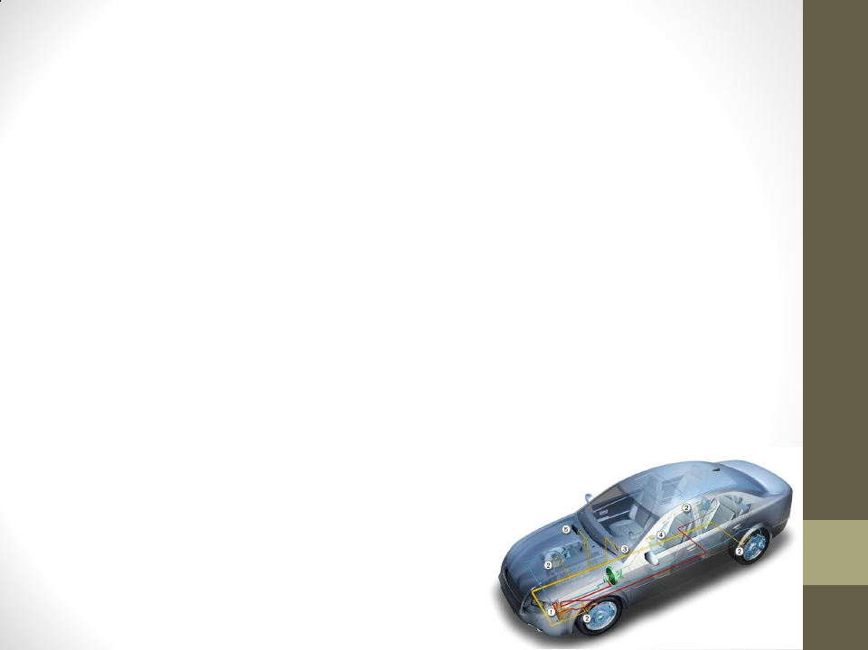
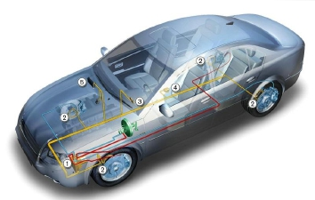
The Application of IoT(5)
Scenario: Transportation
• A network of sensors set up throughout a vehicle can interact with its
surroundings to provide valuable feedback on local roads, weather and
traffic conditions to the car driver, enabling adaptive drive systems to
respond accordingly
• This may involve automatic activation of braking systems or speed control
via fuel management systems. Condition and event detection sensors can
activate systems to maintain driver and passenger comfort and safety
through the use of airbags and seatbelt pre-tensioning
• Sensors for fatigue and mood monitoring based on driving conditions,
driver behaviour and facial indicators can interact
to ensure safe driving by activating warning systems
or directly controlling the vehicle

Slide 34
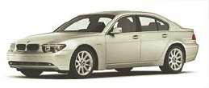
The Application of IoT(5)
Scenario: Transportation
• In 2005, 30 – 90 processors per car
Engine control, Break system, Airbag deployment system
Windshield wiper, Door locks, Entertainment system
• Cars are sensors and actuators in V2V networks
Active networked safety alerts
Autonomous navigation
• Future Transportation Systems
Incorporate both single person and mass transportation vehicles, air and ground
transportations.
Achieve efficiency, safety, stability using real-time control and optimization.

Slide 35
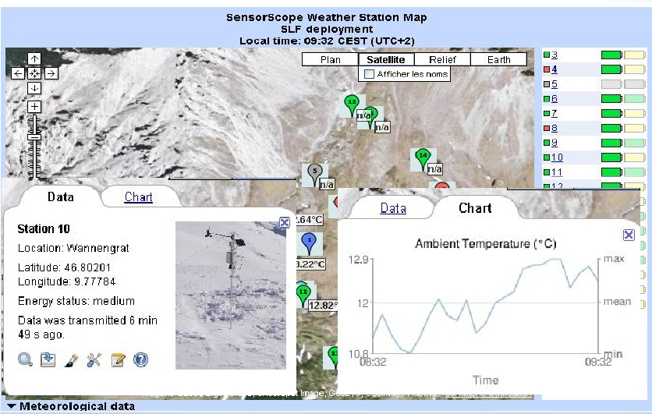
The Application of IoT(6)
Scenario : Monitoring the Environment

Slide 36
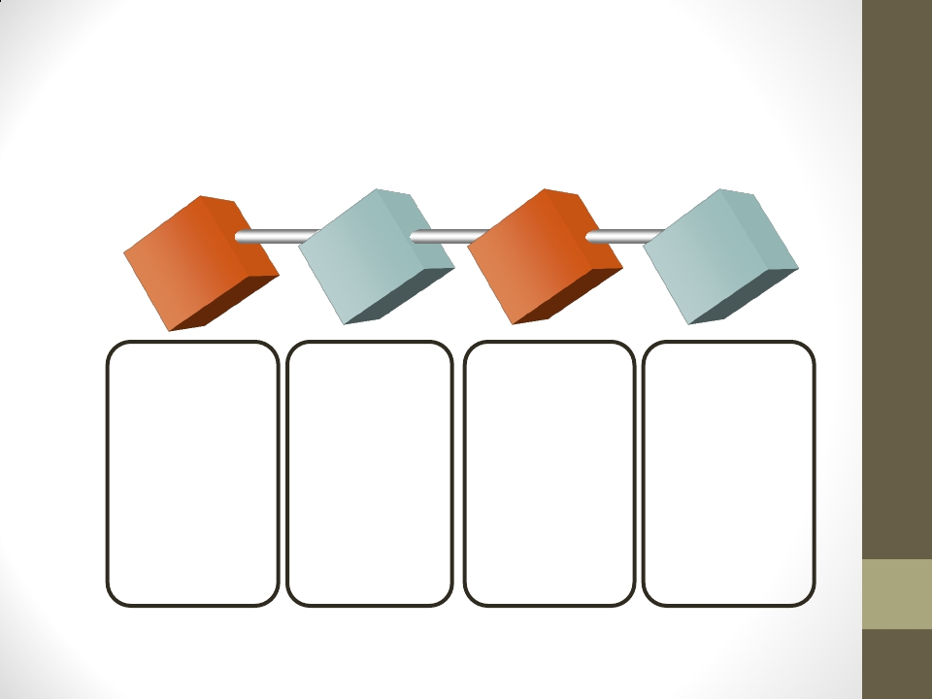
State of the Art of IoT
Enabling Technologies
RFID
Sensor
Smart Tech
Nano Tech
To identify
and track
the data of
things
To collect
and process
the data to
detect the
changes in
the physical
status of
things
To enhance the
power of the
network by
devolving
processing
capabilities to
different part of
the network.
To make the
smaller and
smaller things
have the
ability to
connect and
interact.

Slide 37
SensorTechnology
The ability to detect changes in the physical status of things is
essential for recording changes in the environment.
Wireless sensor technology play a pivotal role in bridging the
gap between the physical and virtual worlds, and enabling
things to respond to changes in their physical environment.
Sensors collect data from their environment, generating
information and raising awareness about context.
Example: sensors in an electronic jacket can collect information about
changes in external temperature and the parameters of the jacket can be
adjusted accordingly

Slide 38
State of the Art of IoT
Research Groups
1
MIT Auto-ID Lab & EPC
Global.
Stanford University
Georgia Institute of
Technology
Cambridge Univ
2
EPFL & ETH Zurich
Information and
Communication Systems
Research Group
Chemnitz University of
Technology
VSR Group
3
Nokia
SAP
IBM
GOOGLE
AMBIENT
Metro Group
Siemens
Sun
Cisco
GE

Slide 39
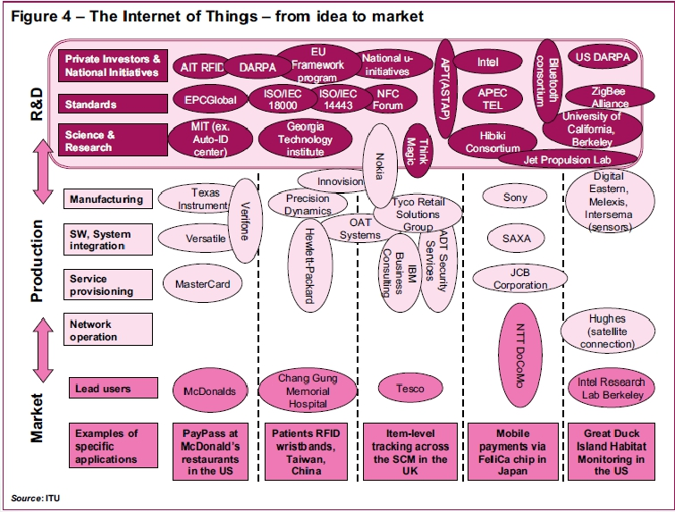
State of the Art of IoT

Slide 40
The Challenge of IoT
Total challenge of IoT
1. Technological Standardization in most areas are still
remain fragmented.
2. managing and fostering rapid innovation is a challenge for
governments
3. privacy and security
4. Absence of governance

Slide 46
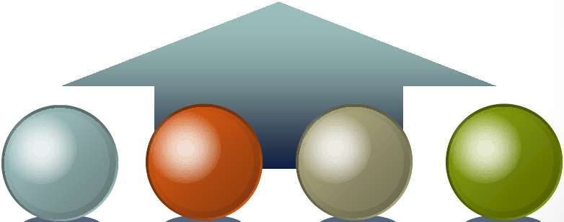
The Challenge of IoT
How to convincing users that the IoT technology will
protect their data and privacy when tracking
Potential Solutions
Legal &
Regulatory
Technical
Control
Market
Self-regulation
Social Ethic

Slide 47
Future Privacy Policy Roadmap

Slide 48
Fundamental Privacy Principles
Transparency
Individual Control
Respect for Context
Focused Collection and Responsible Use
Security
Access and Accuracy
Accountability

Slide 51
IPv6 Deployment
• The world ran out of IPv4 addresses in February 2010
• No real impact has been seen by the general public
– This situation has the potential to slow IoT’s progress
– The potentially billions of new sensors will require unique
IP addresses
• IPv6 makes the management of networks easier
– Due to auto configuration capabilities
• IPv6 also offers improved security features

Slide 52
Sensor Energy
• For IoT to reach its full potential, sensors
will need to be self-sustaining
• Imagine changing batteries in billions of
devices deployed across the planet (and
even in space)
– Obviously, this isn’t possible
• Need a way for sensors to generate
electricity from environmental elements
– Such as vibrations, light, and airflow

Slide 53
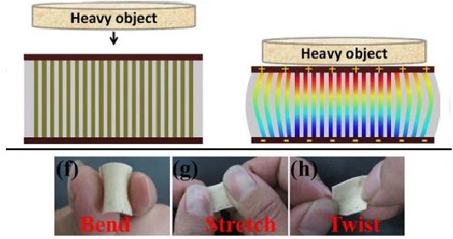
… Sensor Energy
• Nanogenerator
– A flexible chip that uses body movements such as the pinch of a
finger to generate electricity
• 2011 announcement
• 2013 update

Slide 54
Internet of Things
FUTURE OF IOT

Slide 55
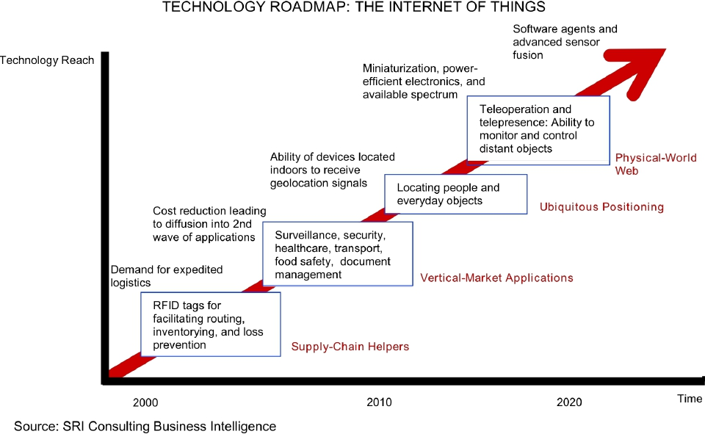

Slide 56
Concluding Thoughts
• IoT is at a stage where disparate networks and a multitude
of sensors must come together and interoperate under a
common set of standards
– This effort will require businesses, governments, standards
organizations, and academia to work together toward a
common goal
• For IoT to gain acceptance among the general populace,
service providers and others must deliver applications that
bring tangible value to peoples’ lives
– IoT must not represent the advancement of technology for
technology’s sake; the industry needs to demonstrate value in
human terms

Slide 57
Concluding Thoughts
• IoT is happening now, with tremendous transformational potential.
But the challenges must be addressed to realize the opportunities and
Benefits
• It will take Informed engagement, dialogue, and collaboration
across a range of stakeholders to find solutions and to plot the most
effective ways forward.

Slide 58
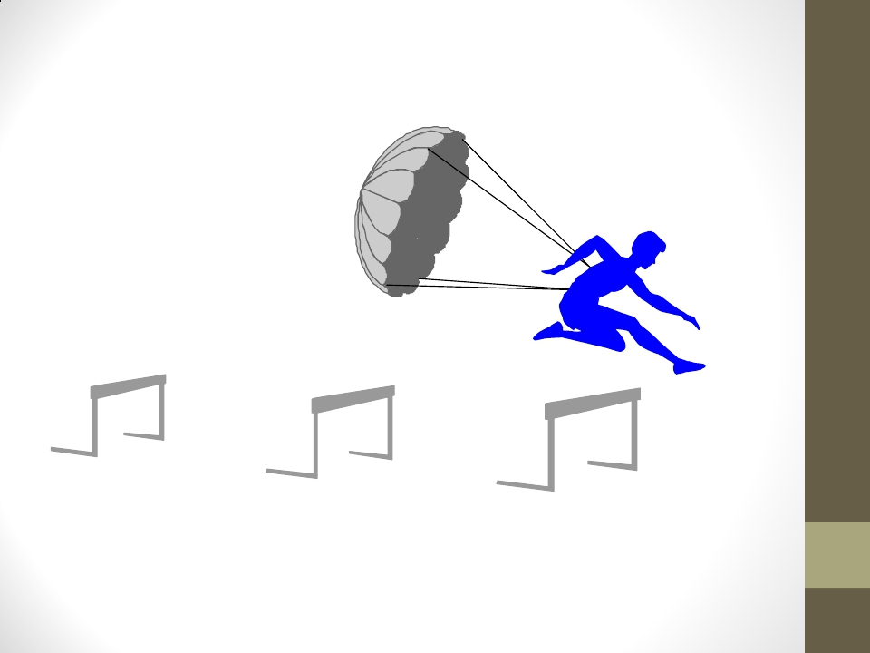
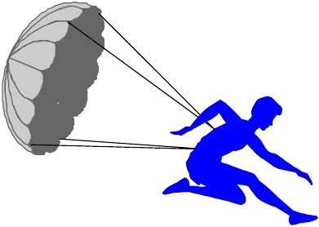
Road is Difficult, but Future is Bright
◆ Any TIME
◆ Any PLACE
◆ Any THING

Slide 59
Reading Suggestions
The Internet of Things : How the Next Evolution of the Internet Is
Changing Everything
– Cisco Internet Business Solutions Group (IBSG)
The Internet of Things, ITU Internet Report
– http://www.itu.int/dms_pub/itu-s/opb/pol/S-POL-IR.IT-2005-SUM-PDF-E.pdf
The Internet of Things, McKinsey Quarterly
– http://www.mckinsey.com/insights/high_tech_telecoms_internet/
the_internet_of_things
Understanding the Three Basic Layers of the IoT
– http://www.fundacionbankinter.org/system/documents/8193/original/
Chapter_3_Understanding_the_three_basic_layers.pdf
The Internet of Things
– http://www.ida.gov.sg/~/media/Files/Infocomm%20Landscape/Technology/
TechnologyRoadmap/InternetOfThings.pdf
•
•
•
•
•

Slide 60
Acknowledgements
Dr Saad Liaquat Kiani
LiaquatKianiS@cardi".ac.uk / saad.kiani@cern.ch
QianZhang
FYTGS,HKUST
Karen Rose Sr. Director, Strategy & Analysis rose@isoc.org

Slide 61
THANK YOU

Slide 62
Fair Information Practice Principles

Slide 63
Fair Information Practice Principles
The Fair Information Practice Principles (FIPPs) are a widely accepted framework of defining principles to be used in the evaluation and consideration of systems, processes, or programs that affect individual privacy.
Transparency
Individual Control
Respect for Context
Focused Collection and Responsible Use
Security
Access and Accuracy
Accountability

Slide 64
2015 Legislative Summary

Slide 65
2015 Legislative Summary
AB-66 (Weber) - Peace officers: body worn cameras
AB-83 (Gatto) - Personal Data
AB-195 (Chau) - Unauthorized access to computer systems
AB-259 (Dabahneh) - Personal information: privacy

Slide 66
2015 Legislative Summary
AB-856 (Calderon) - Invasion of Privacy
AB-964 (Chau) - Civil Law: privacy
AB-1116 ( Privacy Committee) - Connected televisions
AB-1541 (Privacy Committee) - Privacy: personal information

Slide 67
2015 Legislative Summary
SB-30 (Gaines) - Carjacking
SB-34 (Hill) - Automated license plate recognition systems: use of data
SB-178 (Leno) - Privacy: electronic communications: search warrant
SB-570 (Jackson) - Personal information: privacy: breach

Slide 68
2015 Legislative Summary
SB-576 (Leno) - Mobile applications: geolocation information: privacy
SB-690 (Stone)- Stalking
SB-741 (Hill) - Mobile communications: privacy
SB-1177 (Steinberg) - Privacy: students of 2014

Slide 69
Future Privacy Policy Roadmap

Slide 70
Fundamental Privacy Principles
Transparency
Individual Control
Respect for Context
Focused Collection and Responsible Use
Security
Access and Accuracy
Accountability

Slide 71
1. Transparency
Expand California’s Online Privacy Protection Act (CalOPPA) to include:
A short-form summary at the beginning of every privacy policy
Notice of what “type” of IoT sensor information is collected
Notice of what “specific” personal information an organization has collected
Notice of what “purpose” information is collected and shared with whom
Application of CalOPPA to State agencies and their use of personal information

Slide 72
2. Individual Control
Require opt-in/opt-out consent distinct from the operation of the IoT device
Provide more consumer privacy choices—Not simply all or nothing
Provide the ability to delete information
Privacy by Design—default IoT settings for privacy

Slide 73
3. Respect for Context
Restrict third-party sale of sensitive PII for marketing or unrelated advertising purposes
Respect the purpose for which the data is collected
Prohibit the use of data in unexpected ways
Require a “reasonable expectation of privacy” standard

Slide 74
4. Focused Collection and Responsible Use
Expand the definition of “Personally Identifiable Information” (PII)
Expand the definition of “Personal Information” under the Information Practices Act
Provide data minimization incentives for organizations
Provide data correction and “second-hand” exclusion
Responsible use of data based on fairness

Slide 75
5. Security
Provide for increased data breach notification of non-encrypted re-identified information
Require robust identity theft protection
Require reasonable security procedures and practices of businesses
Incentivize two-factor authentication / Biometric authentication
Align product warranty and customer expectations with security fixes and product life-cycle

Slide 76
6. Access and Accuracy
“Right to Know” what information an organization has collected about you
Right to know what third-parties an organization has shared your PII with
Right to correct inaccuracies in your information
Right to export or transfer your information
Right to access digital assets or information from deceased heirs

Slide 77
7. Accountability
Provide stronger enforcement mechanisms:
Federal Trade Commission (FTC)
California Office of the Attorney General
Consumer private right of action
Data Breach Notification Requirements
EU-U.S. Privacy Shield Safe Harbor

Slide 78
Thank You
Girard.Kelly@asm.ca.gov

